Slide 1


SMART INDIA HACKATHON 2024
Problem Statement ID – SIH1555
Problem Statement Title- virtual herbal garden
Theme- MedTech / Bio Tech / Health Tech
PS Category- Software
Team ID-
Team Name (Registered on portal)

Slide 2

Virtual Herbal Garden
Byte Bard
Idea Overview: Virtual Herbal Garden is a digital platform designed to offer an interactive and immersive educational experience centred around medicinal plants used in the AYUSH sector, which includes Ayurveda, Yoga & Naturopathy, Unani, Siddha, and Homeopathy.
Features: efficiency use of current technologies to make a multi dimensional model of the plant and show casing the usage, features, location, and some common uses of the herb.
User Experience: Describe how the solution will offer an immersive and engaging experience for users, making the knowledge of medicinal plants accessible from anywhere.

Slide 3
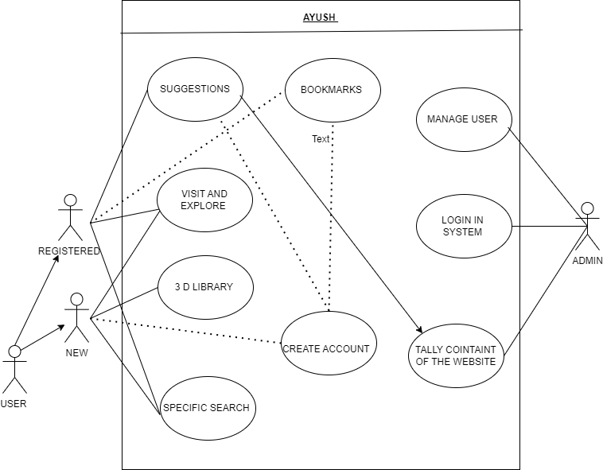

TECHNICAL APPROACH
Byte Bard

Slide 4
FEASIBILITY AND VIABILITY
Byte Bard
High User Engagement: Interactive and engaging features will attract and retain users.
3D Model Optimization: Ensure fast loading and high quality of 3D models.
Cross-Platform Compatibility: Design to work smoothly across various devices and browsers.
Expert Collaboration: Work with AYUSH professionals to ensure accurate plant information.
User Testing: Refine the interface through extensive user testing for ease of use.
Data Security Measures: Implement encryption and regular audits to protect user data.
Scalability: Design the platform to grow with additional features and content over time.
Technology Stack :

Slide 5
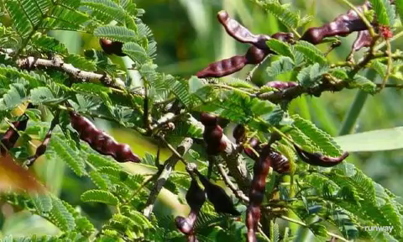
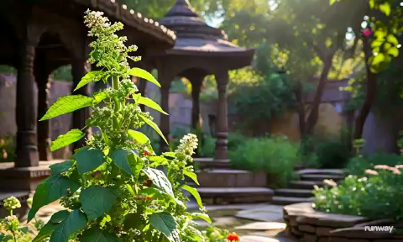
IMPACT AND BENEFITS
Byte Bard
Potential impact on the target audience
Benefits of the solution (social, economic, environmental, etc.)

Slide 6

RESEARCH AND REFERENCES
Byte Bard
Details / Links of the reference and research work

